Slide 1

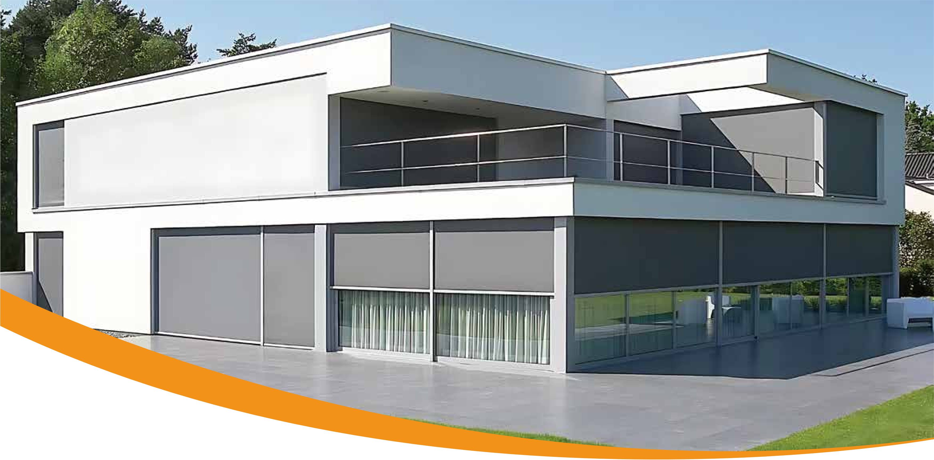


OUTDOOR SPACE SHADING
OVERALL SOLUTION PROVIDER
Shangteng Spring takes its own modern factory as the core, integrates industry leading R&D and production
capabilities with a complete network covering over 200 service providers across the country, and builds a full
industrial chain closed loop from product R&D, customized production to terminal services As a professional
manufacturer of outdoor electric shading products, we not only have complete OEM/ODM customized service
capabilities, but also can precisely meet the personalized functional requirements of diﬀerent regions around
the world Moreover, relying on our own production base, we achieve full process control from raw material
procurement to production processes, ensuring that every product meets strict quality standards We provide
customers with one stop solutions ranging from scheme design to product production and supply chain
services With the core advantages of eﬃcient response, stable quality and continuous innovation, we partici
pate in the high standard customization of the industry
INTELLIGENT WINDPROOF AND SUNSHADE ROLLER BLINDS
Our own factory · One-stop OEM/ODM customization

Slide 2
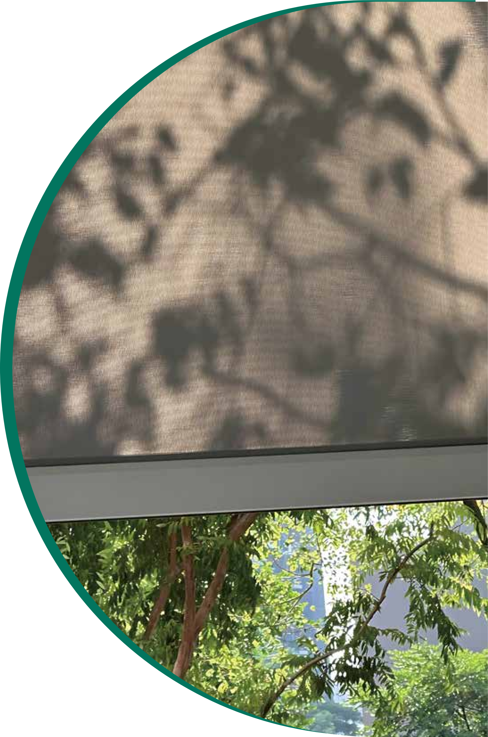




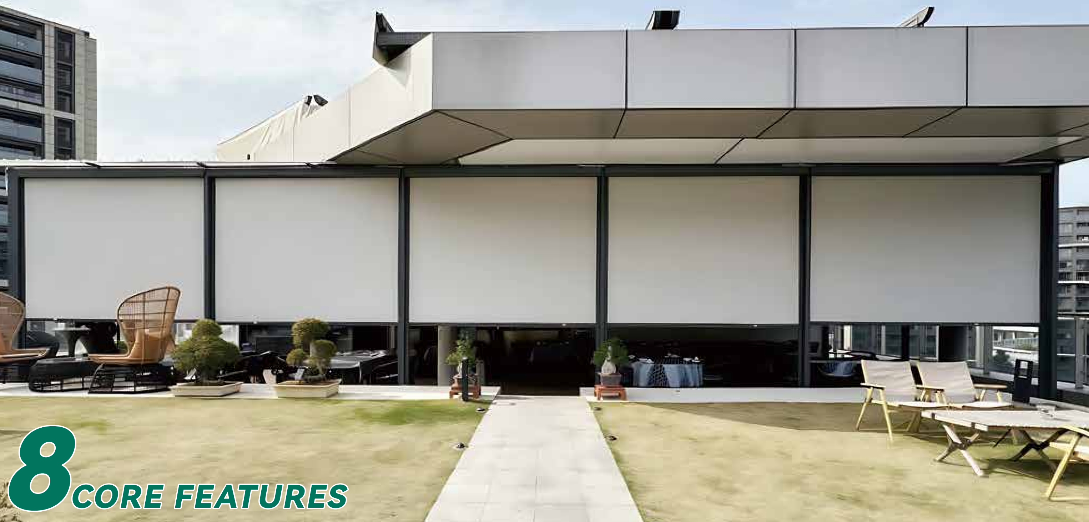
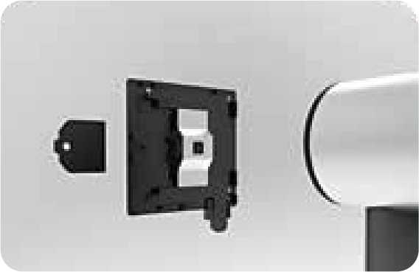
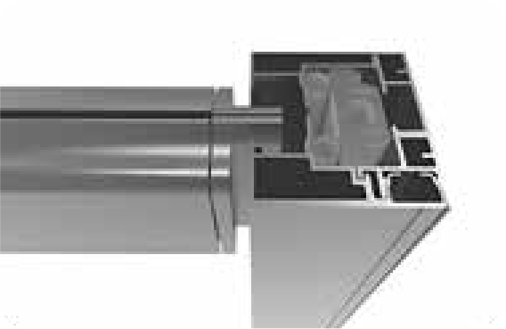
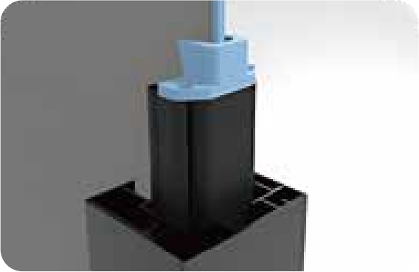
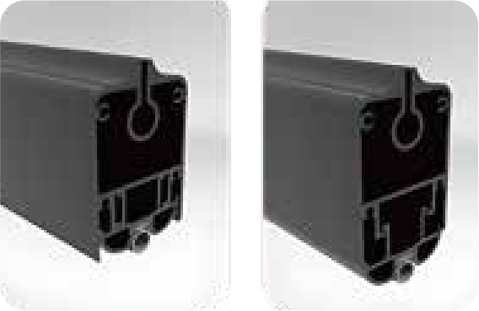








Product Introduction
Product Features
Inspired by modern architectural aesthetics, a minimalist protective system is meticulously crafted. The selected aluminum alloy frame and B1 grade
flame-retardant high-end outdoor fabric feature no deformation, no stretch- ing, and tear resistance. While maintaining a panoramic view, it achieves
optical-grade ultraviolet filtration and aerodynamic wind protection perfor- mance. Intelligently block ultraviolet rays to achieve microclimate regulation that allows light to pass through but not heat.
The 0.08mm precision aperture complies with the EU mosquito repellent
standards, forming an invisible protective barrier and seamlessly connecting
different living scenarios. Imported motor system, achieving decibel-level
quiet operation. Unique product structure, professional fabric guide head +
anti-slip bottom beam guide head, can remain stable as before even in strong wind weather.
The quick bracket is easy to disassemble Professional fabric guide heads for
anti-jamming and anti-tearing edges
Remote control operation | Super wind resistance | Shading and heat insulation | Block mosquitoesv | Fireproof and flame-retardant | Translucent and breathable | Grade 8 color fixation | Rainproof and mold-proof
Prevent the bottom beam guide head from protruding out
The retractable bottom beam prevents light leakage from the bottom of the roller shutter

Slide 3


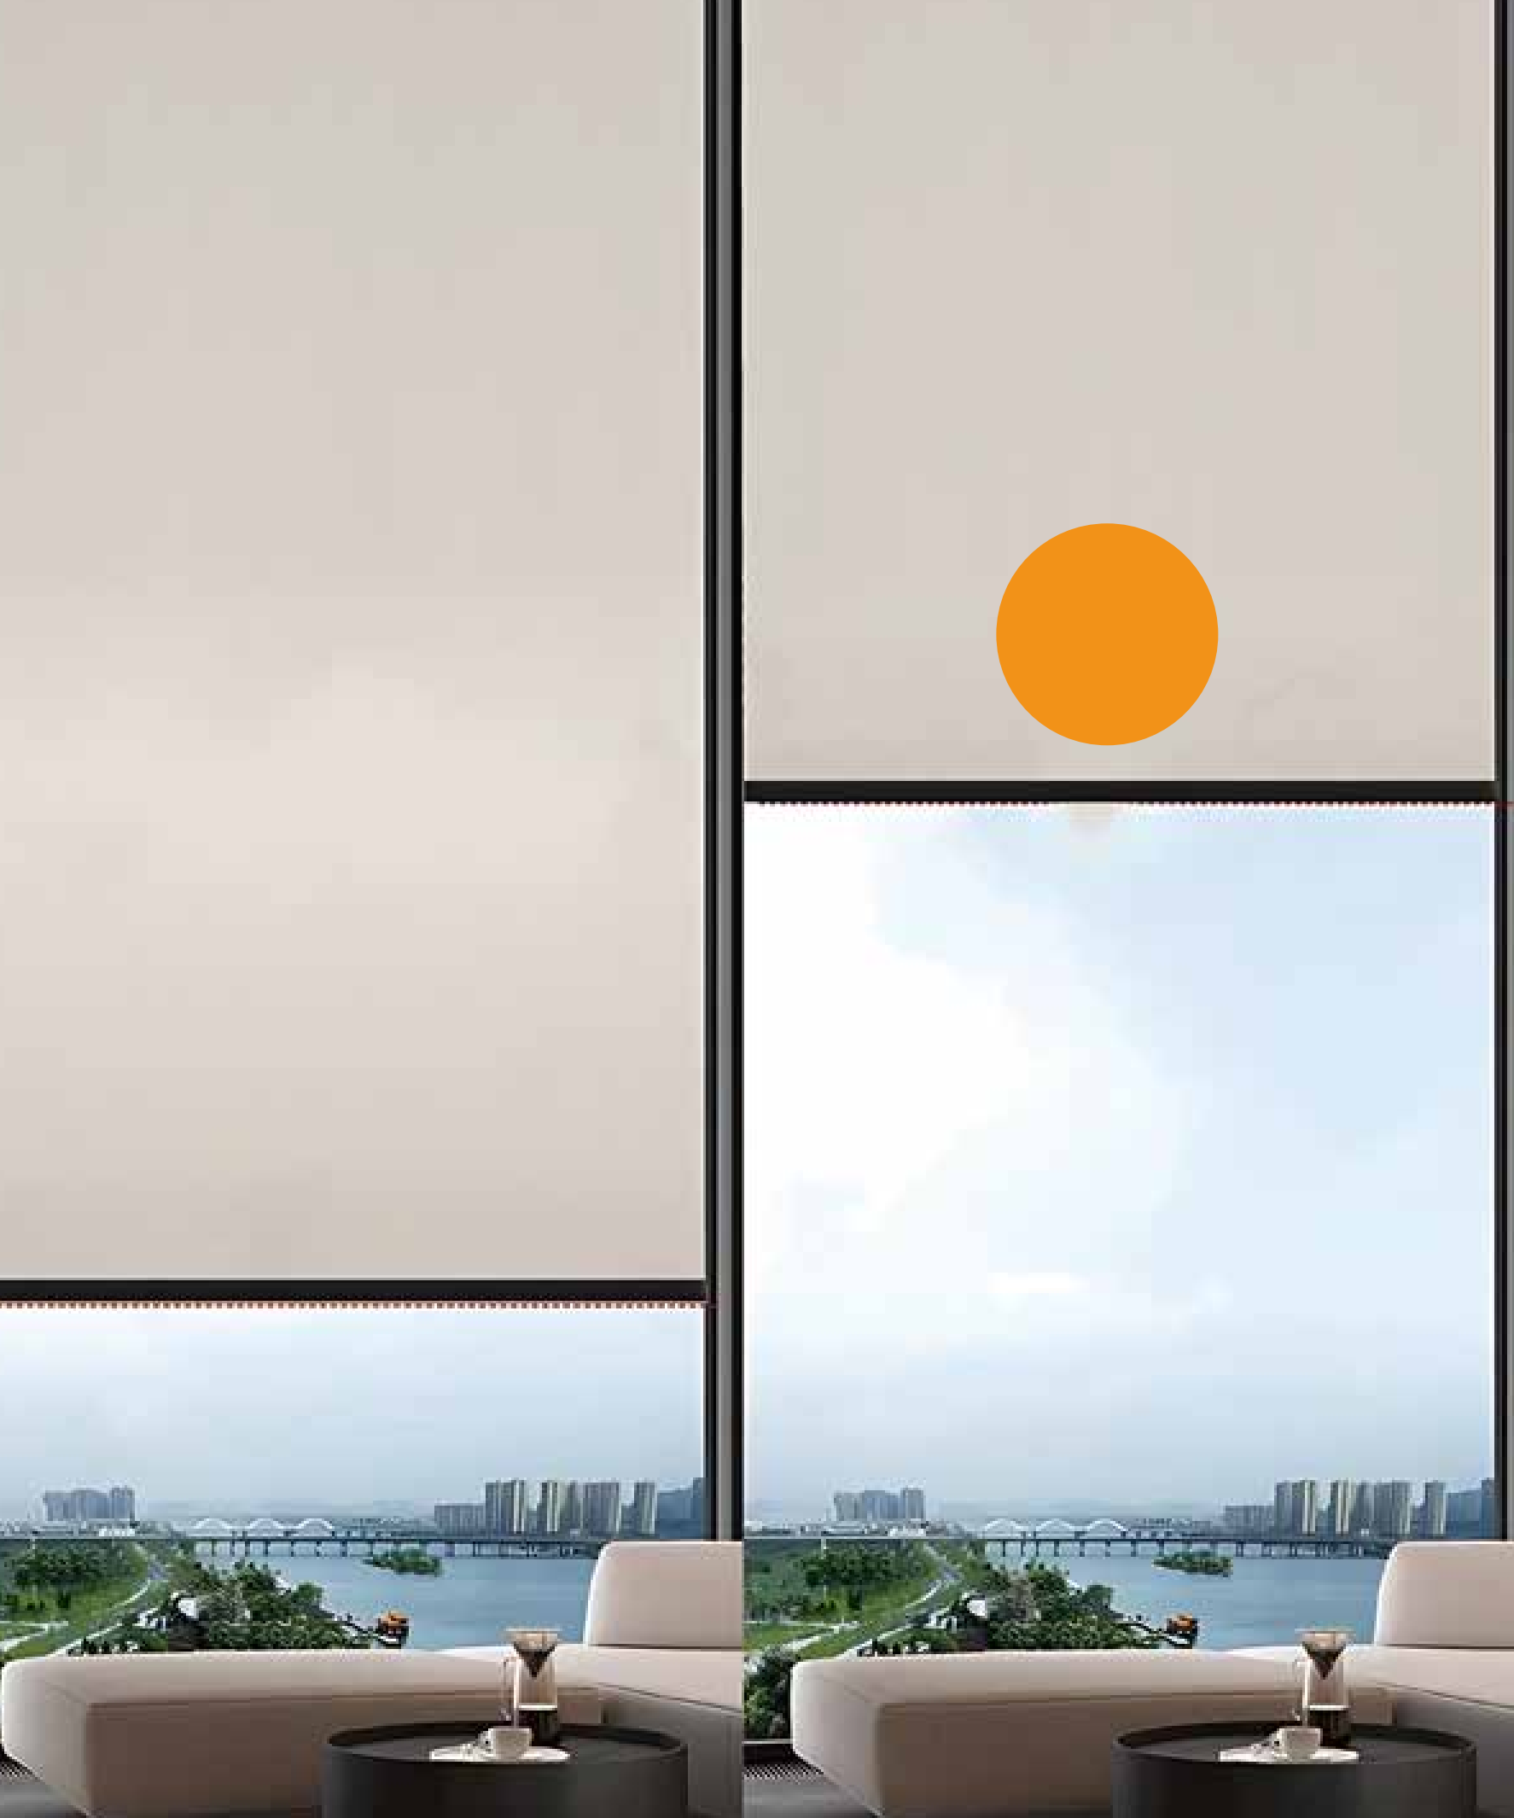
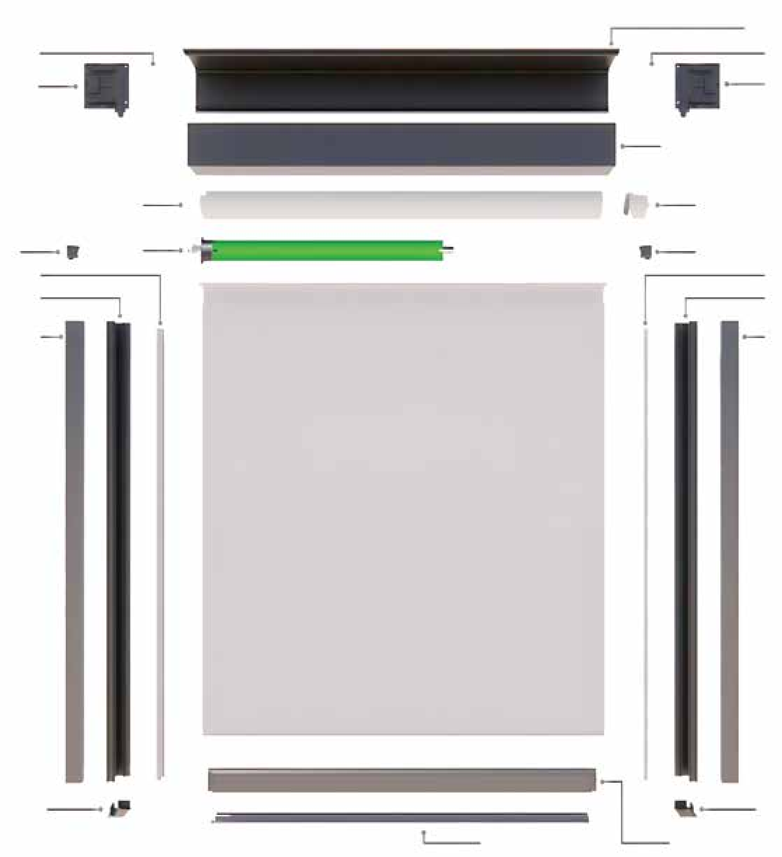
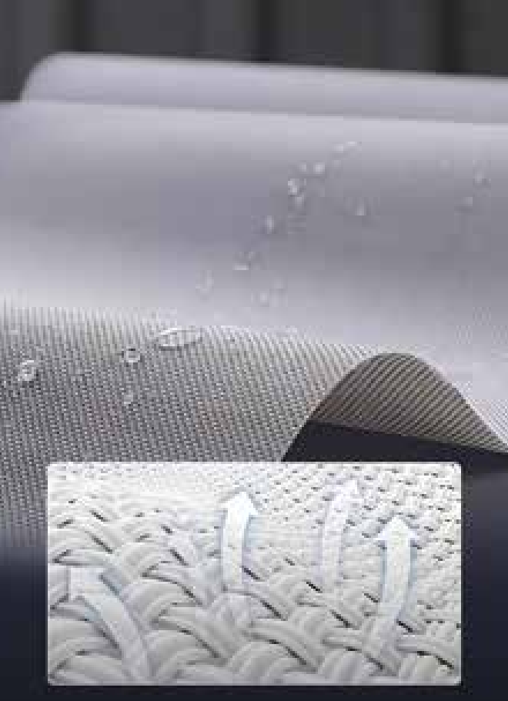
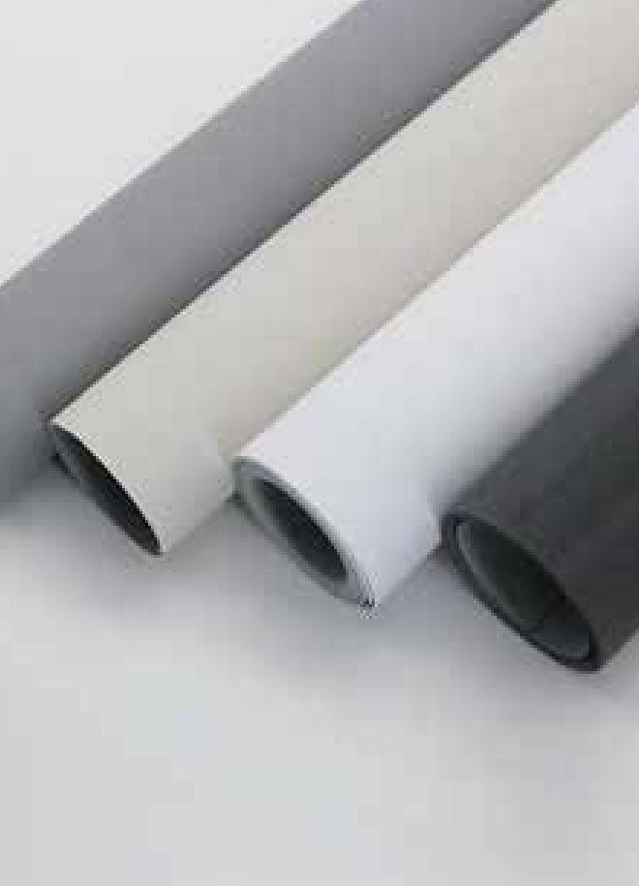
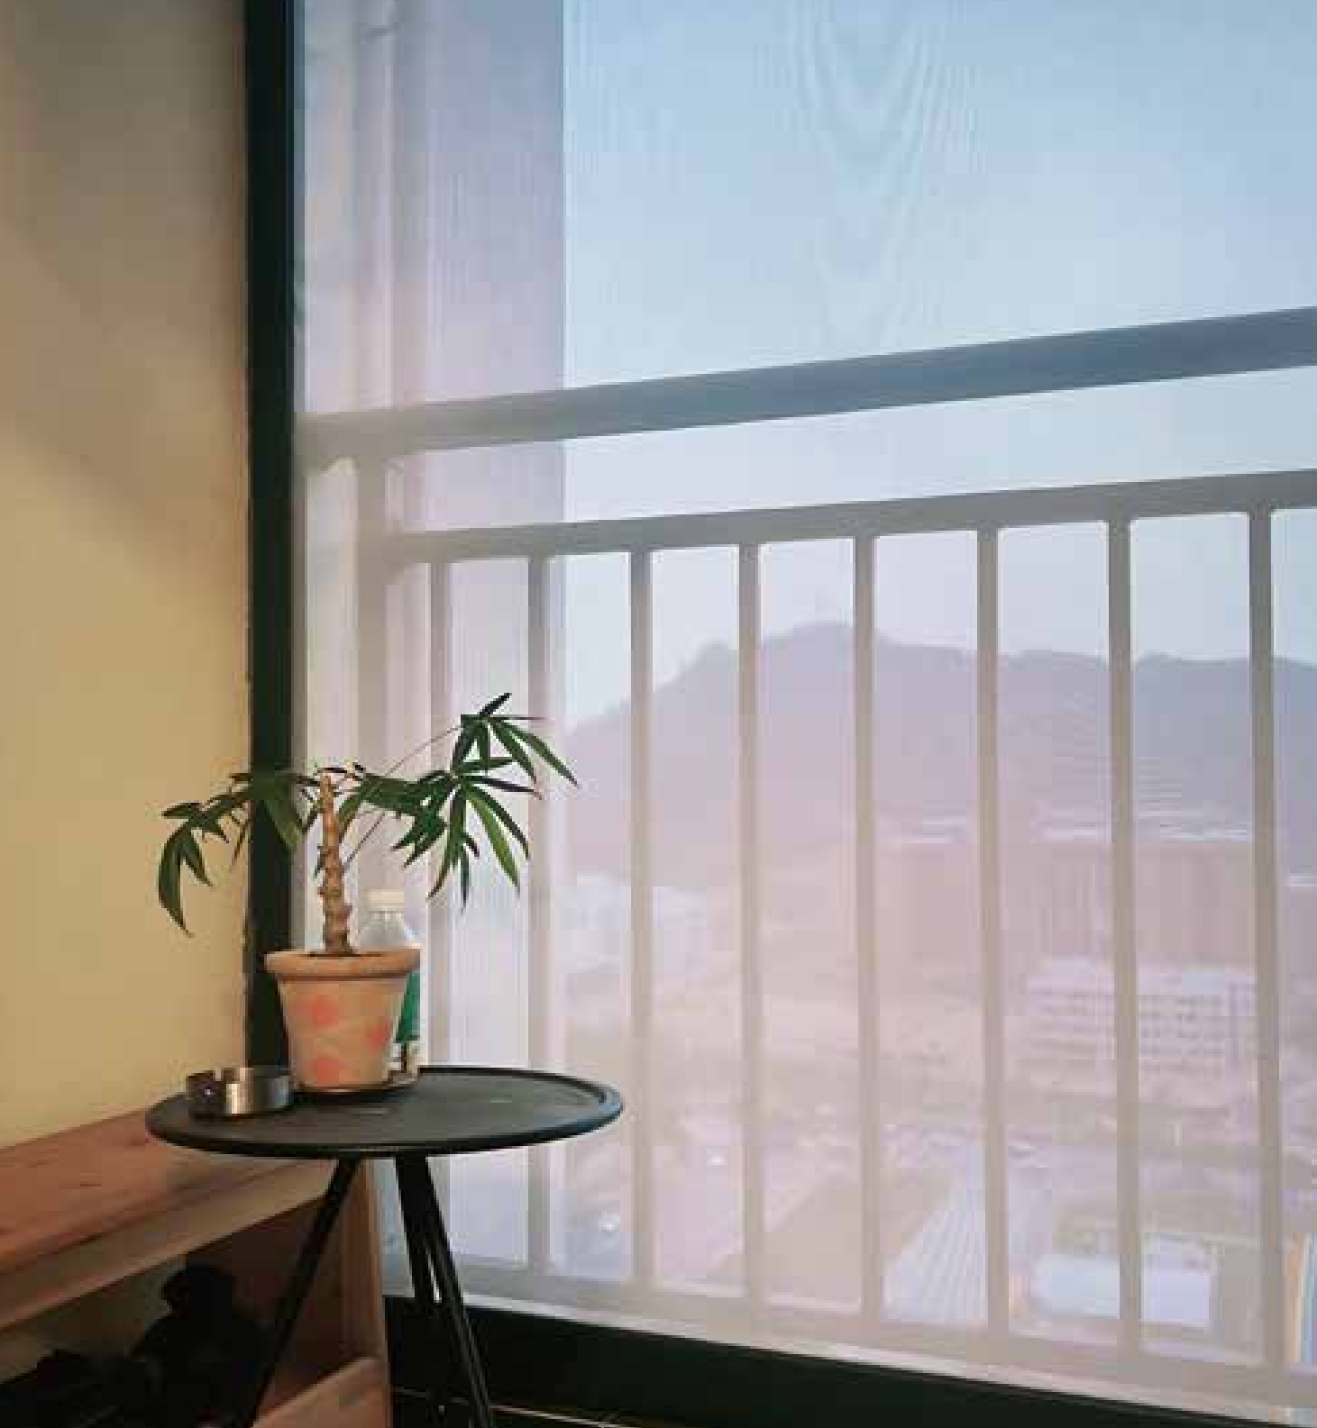


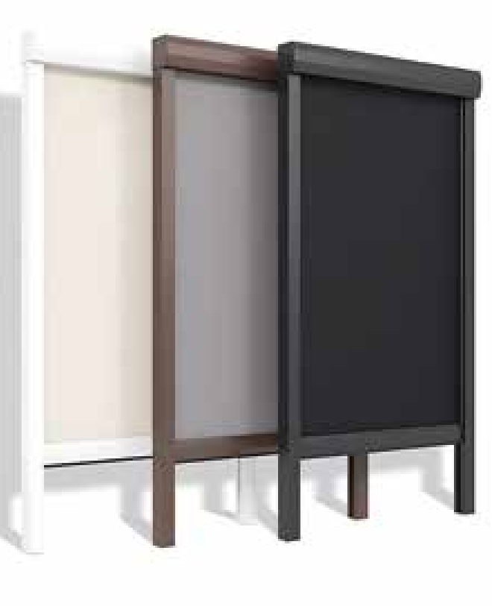
Product details
Product details
Double Protect Stop immediately when encountering obstacles in the up/down movement | The professional motor system is equipped with built-in remote control Supports smart control for Doodle, Mi Home and Tmall Ultra-quiet/with built-in obstacle protection function
Ventilation and air permeability Waterproof and mold-proof
0 aldehyde fabric
Green and environmentally friendly
Rear cover shell
Bracket
End plate
Front hood housing
Tail plug
Fabric guide slot
Inner orbit
Rear orbit
Front orbit
Bracket
End plate
Coil pipe
Motor
Fabric guide slot
Inner orbit Rear orbit
Front orbit
Intelligent remote control
Three frame colors Adapt to multiple scenarios
Guide rail cover | Anti-collision strip | Guide rail cover Bottom beam

Slide 4




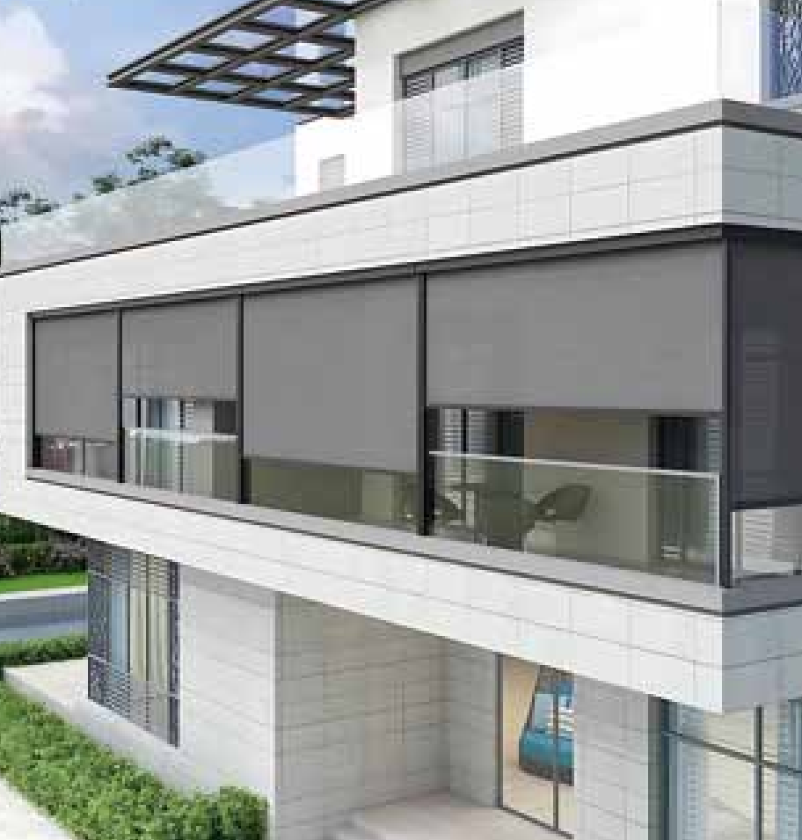
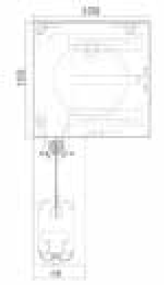
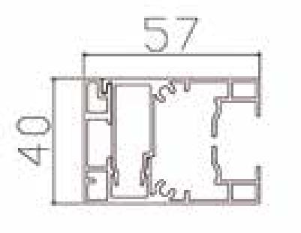
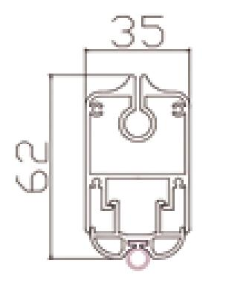
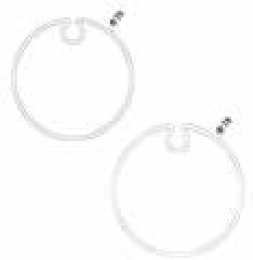

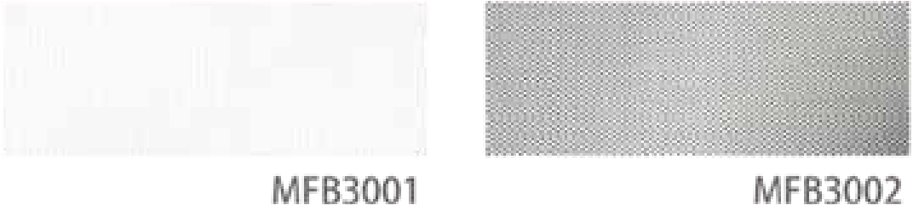
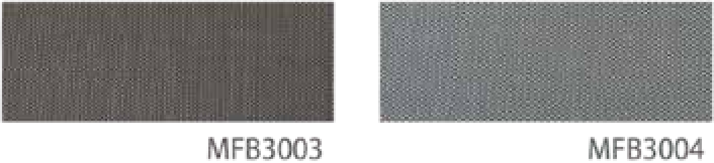
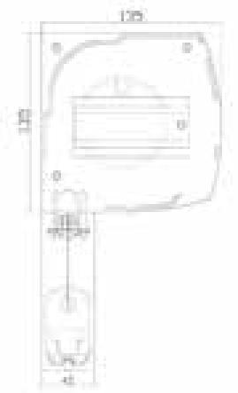

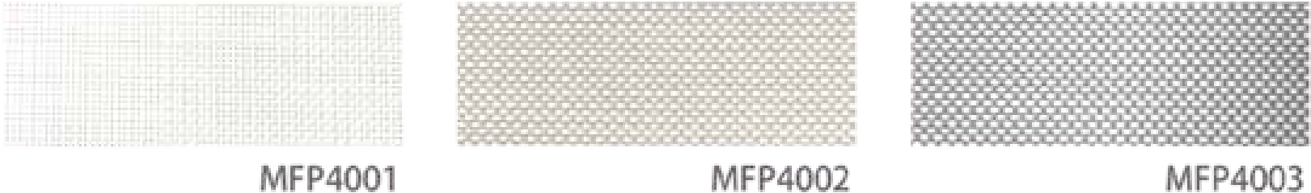
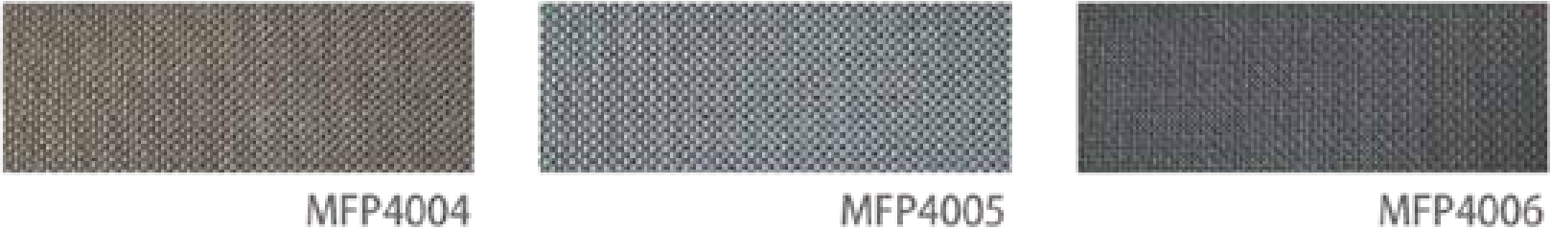

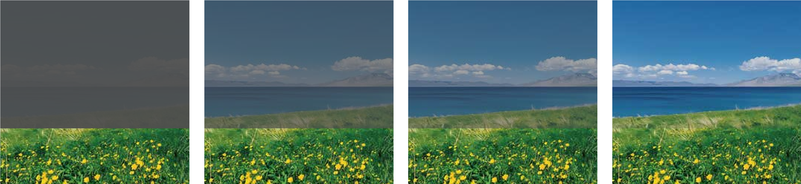
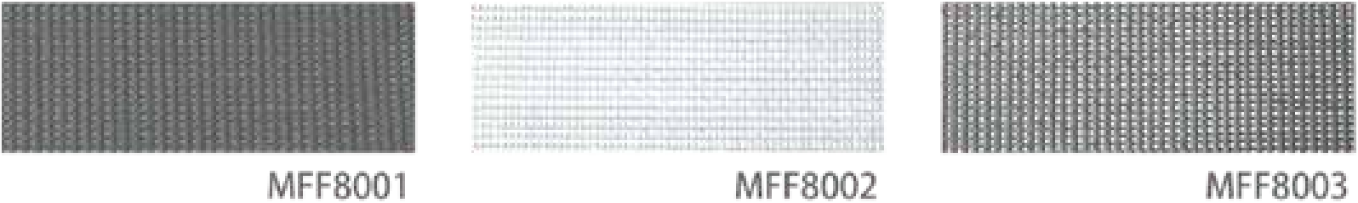

Product Specification
Fabric series
Model | Side view | Side rail | Bottom rail | Coil pipe
108# The maximum width is 5m The maximum height is 4m The width and height cannot be greater than 3 meters simultaneously
135# The maximum width is 5m The maximum height is 4m The width and height cannot be greater than 3 meters simultaneously
Brand: Basden - Flame Retardant B1 Grade ea sail en"
3 series: Full shading [opening rate of about 0%, 30%PET fiber +70% PVC]
4 series: Ultra-high through-view [opening rate of about 5%, 30% polyester fiber +70% PVC]
Brand: Ferrari - Flame Retardant B1 grade serge rer品
8 series: Outdoor high-end fabric, non-deformation, non-stretch, tear resistance, monochrome [hole rate of about 14%]
Example of light transmittance
9 Series: High-end outdoor fabric, non-deformable, non-stretchable, tear-resistant, two-color [opening rate about 4%]
Full shading 4% shading rate 5% shading rate 14% shading rate

Slide 5



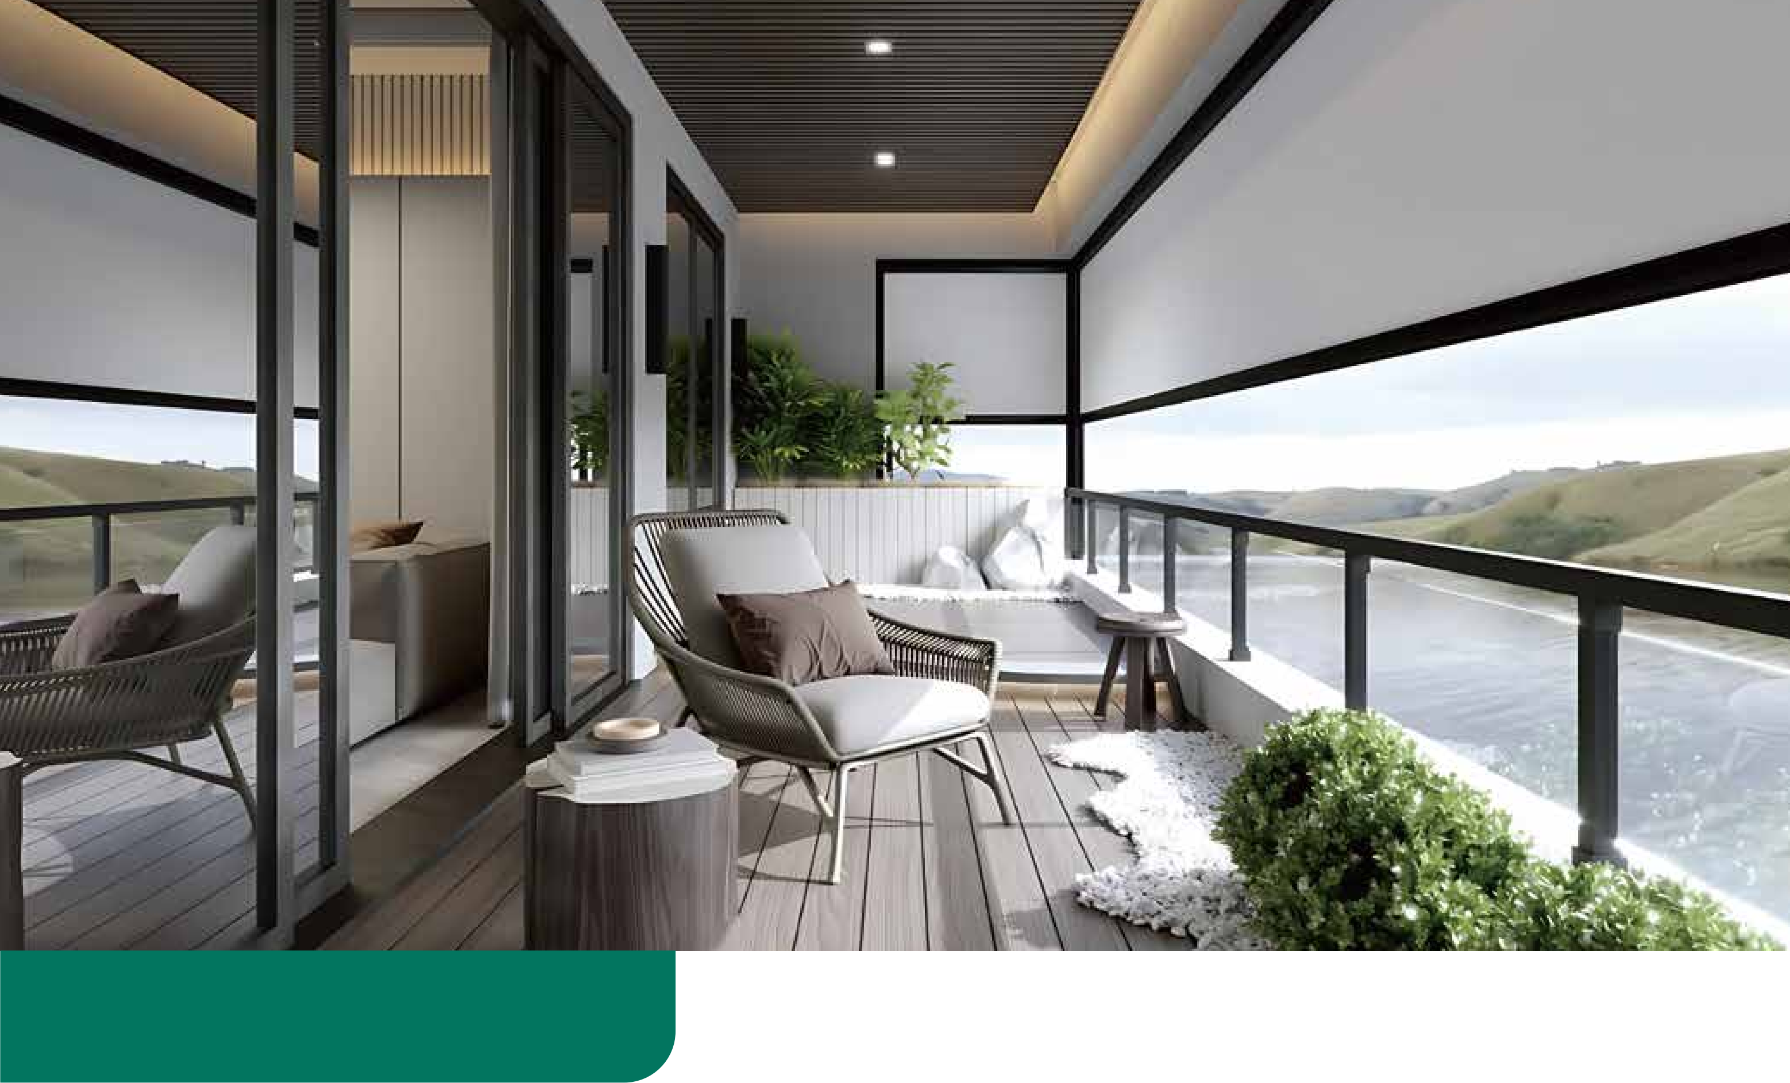
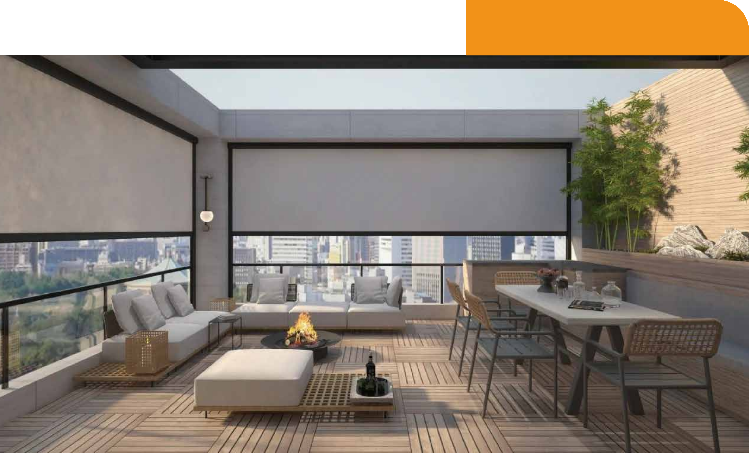
Adapt to the scene
Adapt to the scene
Balcony/Terrace
It does not block the view or affect ventilation, keeping your
balcony always spacious and comfortable
Hotel/Restaurant
You can enjoy a transparent, safe and refreshing private space without the need for enclosure

Slide 6




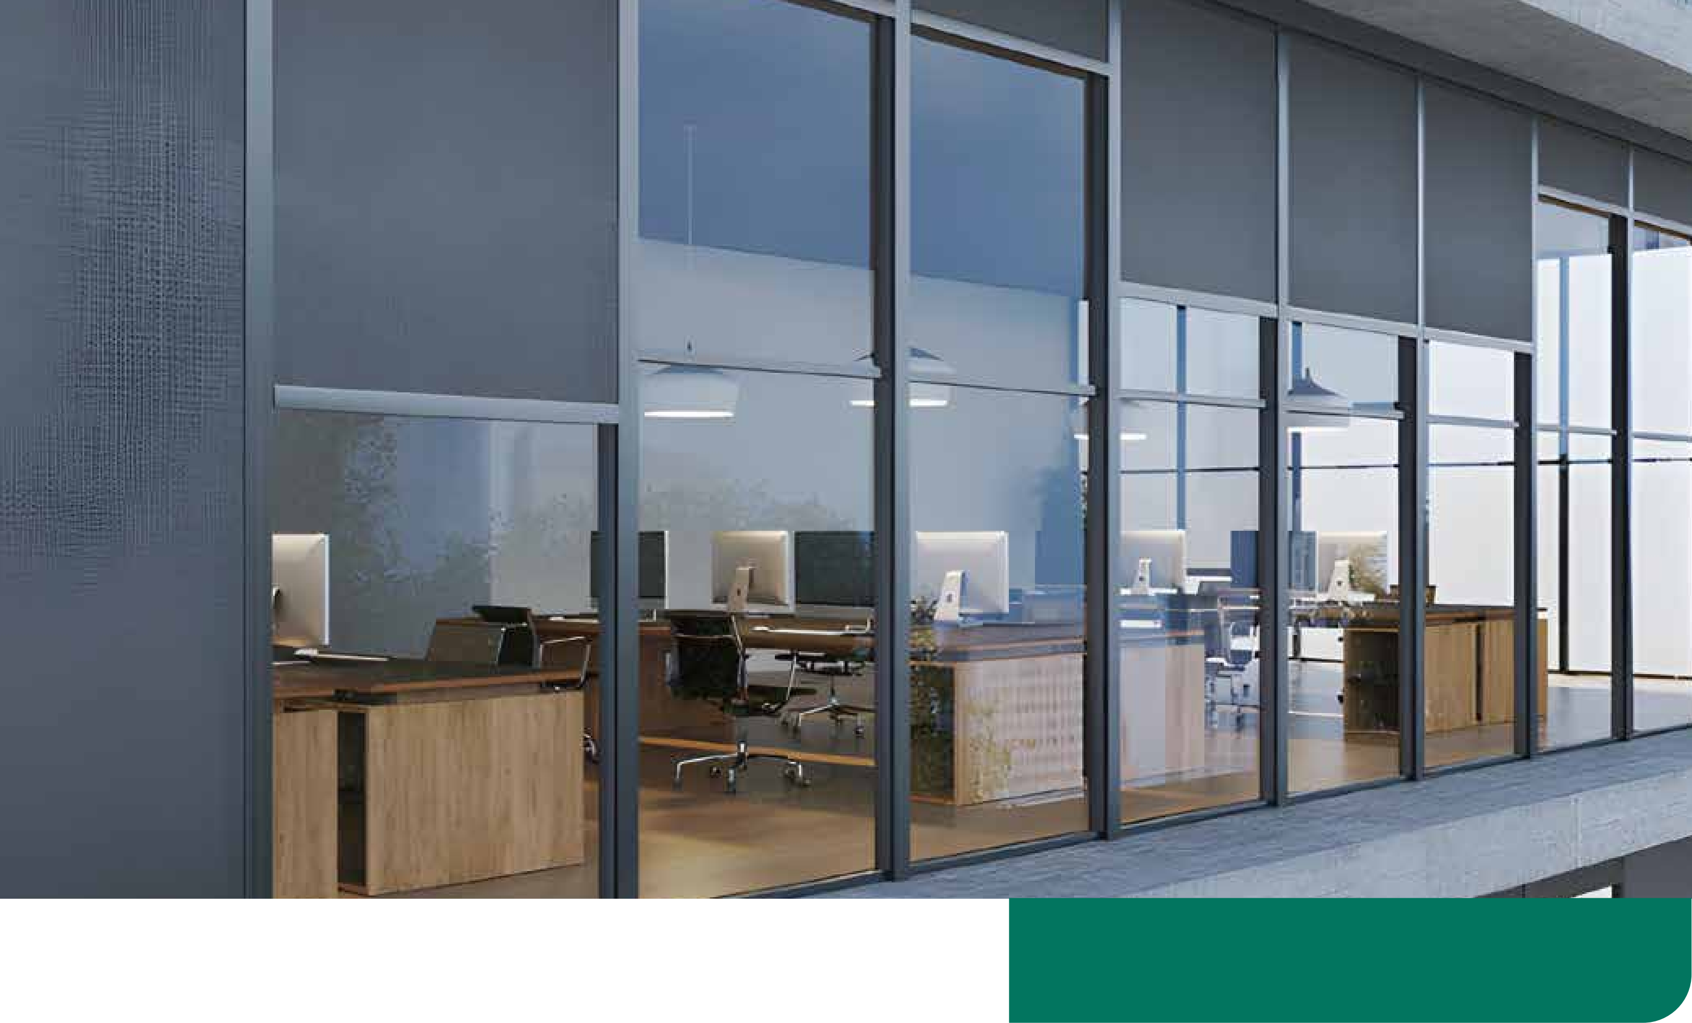
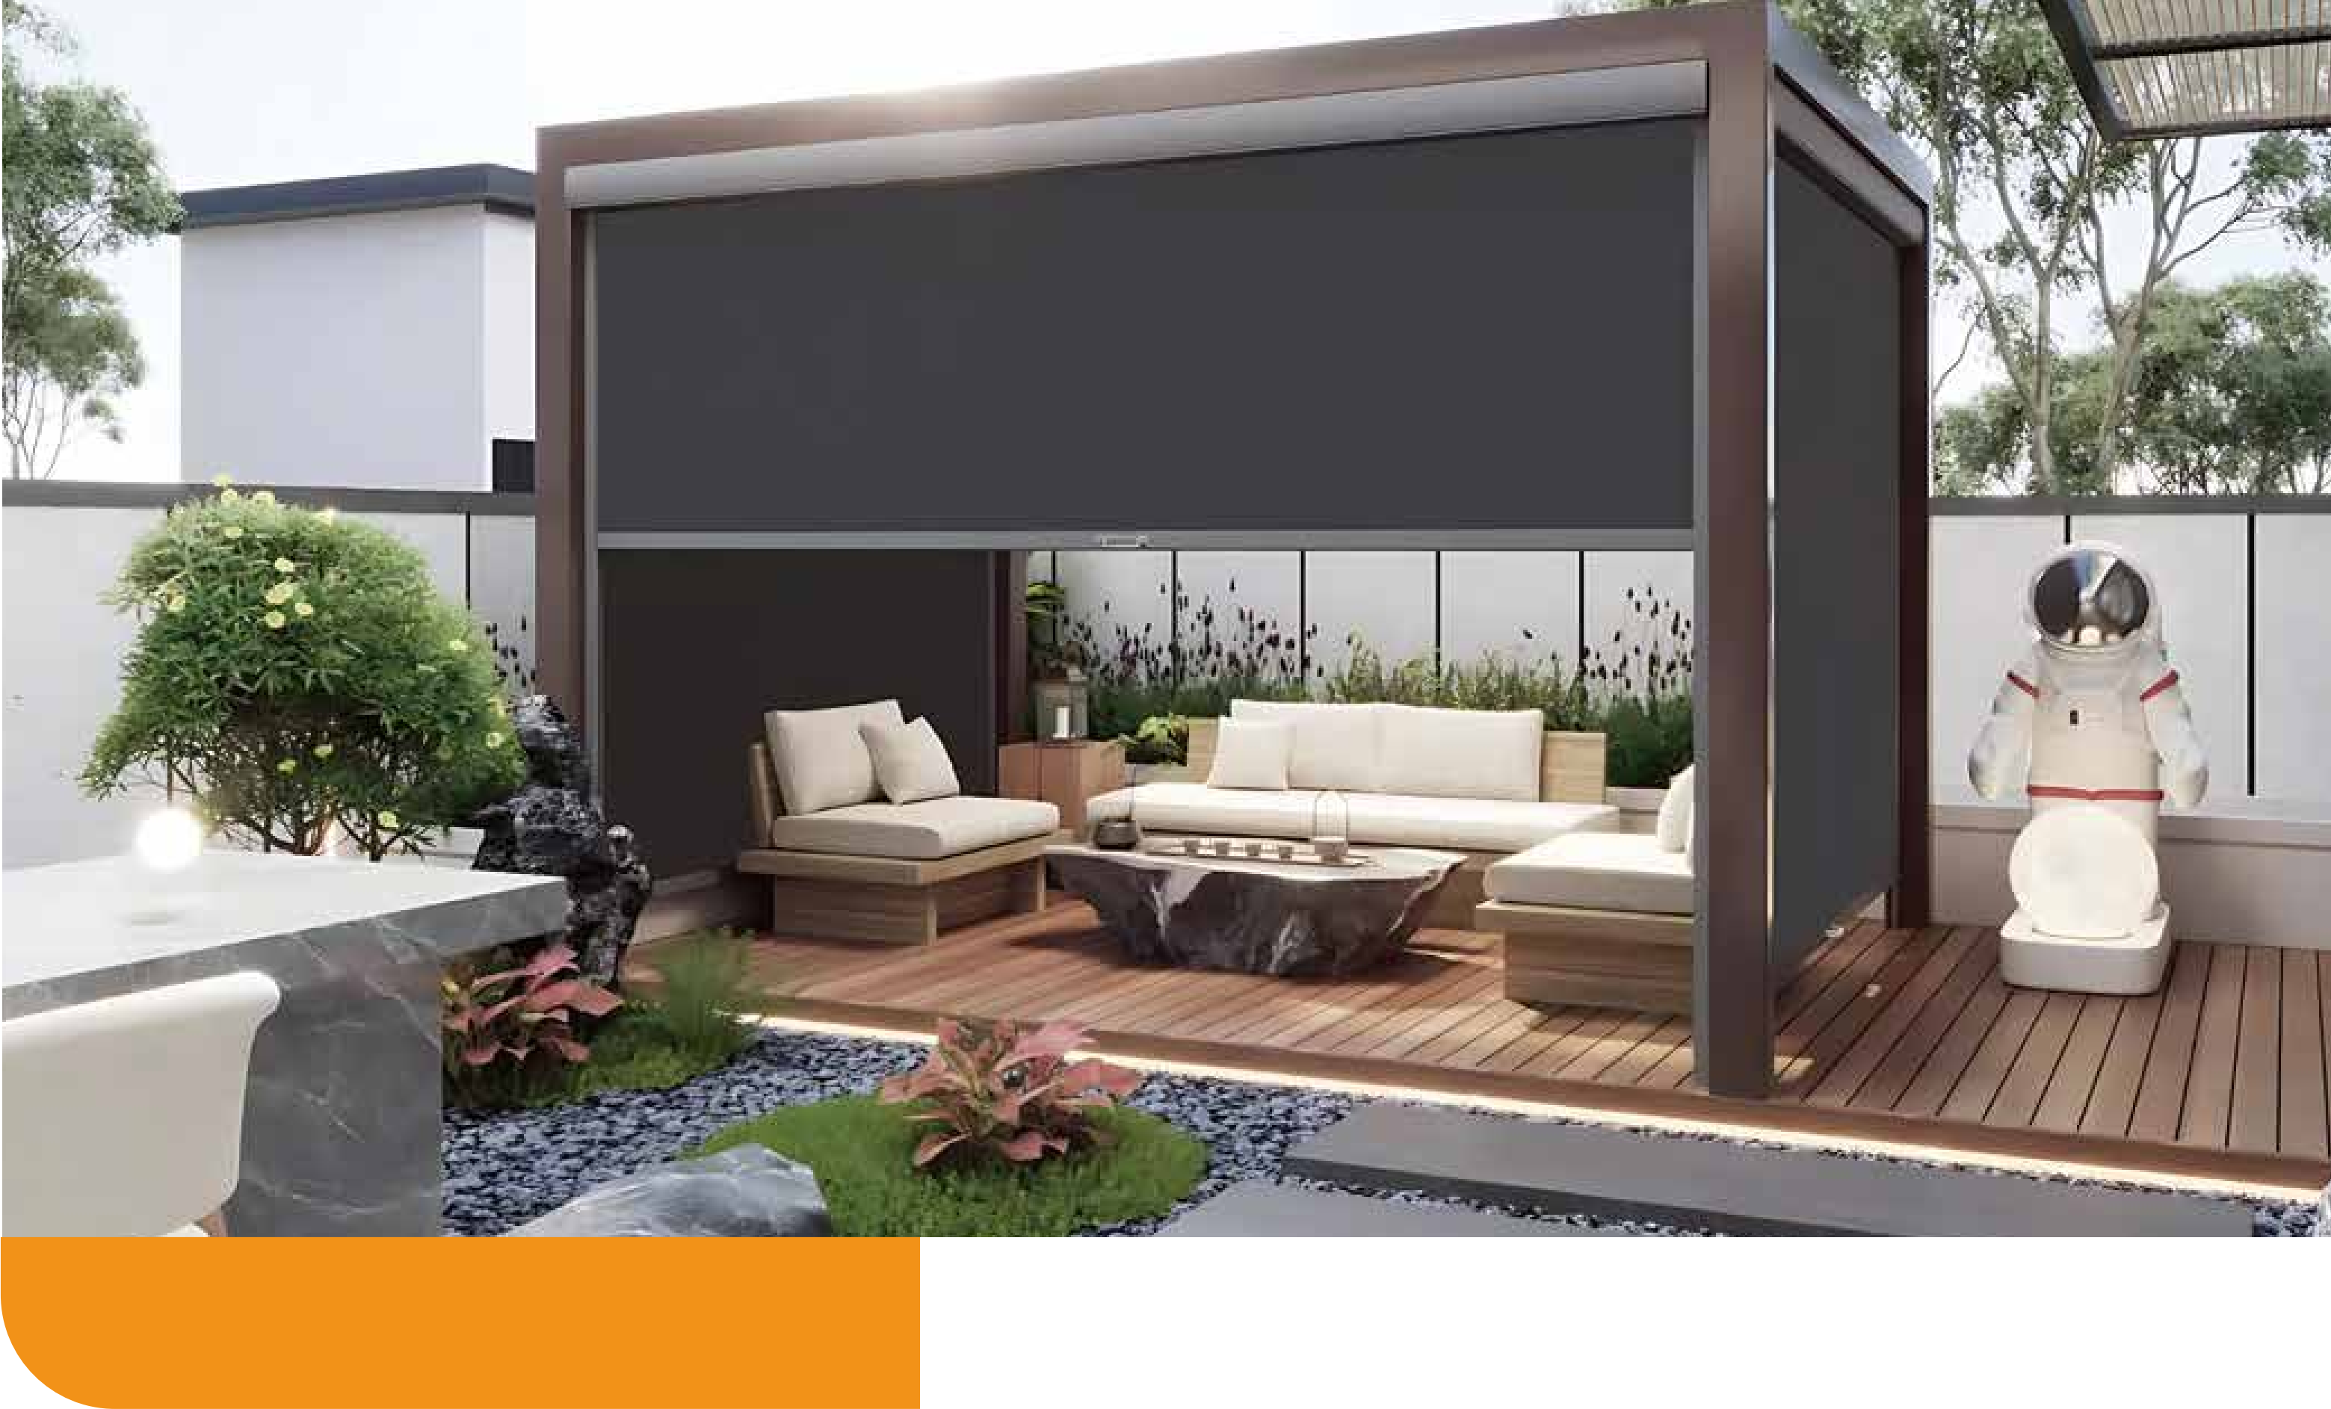
Adapt to the scene
Adapt to the scene
Office area
While maintaining panoramic lighting, create a healthy, efficient and comfortable office micro-environment
Outdoor space
Sunscreen without blocking light, mosquito repellent, creating a
three-dimensional protective space that breathes

